Slide 1

CERIF 1.5 Tutorial
cfFunding
cfFederated Identifier
cfEquipment
cfExpertise
AndSkills
cfFacility
cfQualification
cfResult
Publication
cfService
cfPrize
cfResultPatent
cfResultProduct
cfElectronicAddress
cfProject
cfPostalAddress
November 13th, 2013
euroCRIS Membership Meeting
Porto, Portugal
cfCurriculum
Vitae
cfPerson
cfOrganisation
Unit
cfGeographic
BoundingBox
cfCitation
cfIndicator
cfMeasurement
cfEvent
cfCountry
cfLanguage
cfCurrency

Slide 2
www.eurocris.org
www.eurocris.org
Jan Dvořák
jan.dvorak@infoscience.cz
euroCRIS
CERIF TG Leader since 2013
CRIS2012 (Prague, June 2012) Organizer
Charles University in Prague
Faculty of Arts
  Institute of Information Studies & Librarianship
InfoScience Praha
Research & Development & Innovation Information System
(the national CRIS for CZ)
___
Most slides by Brigitte Jörg

Slide 3
What is Research Information?
www.eurocris.org
www.eurocris.org
Information about:
Researchers
Organisations (Research-performing, Funding)
Funding Programmes, Calls
Projects (Proposed, Ongoing, Completed)
Publications, Patents, Data, Products
Facilities, Equipment, Services
Addresses, Geographic Bindings, Languages
And their Relationships

Slide 4

Who needs Research Information?
www.eurocris.org
www.eurocris.org
visibility, finding collaborations,
competitors, CV generation
Researchers
Decision Makers
performance, strategic decisions,
priorities, comparisons
Funding Organisations
Project Managers
distribution of programs
evaluation of results, finding reviewers
overview of ongoing activities
Research Information
Libraries
Research Organisations
acquisition, dissemination
integration and interoperability
strategic management
Publishers
finding reviewers, editors
Educators
Intermediaries / Brokers
integration of relevant
findings into lectures
and training
finding research results of
potential market or innovative value
General Public
Enterprises
Media
finding information
for participation in projects,
partnerships, usage of results
distribution and
communication
information and education,
interest

Slide 5
Kinds of questions we want to support
www.eurocris.org
www.eurocris.org
How many articles has author X published in 2011 as a first author?
How many times have articles by author X been cited by the end of the previous year?
Did author X publish with institutionally external authors?
In how many FP7 projects does/did organisation Z participate?
How many publications have resulted from project Y?
How many people have been employed in the course of FP7 projects from the 1st call in the New Member States?
How many PhD students have participated in national research projects in country C? In which countries have they earned their masters degrees?
How many women have been involved in FP7 projects?
How often have articles in journal A been requested in 2010?
How many articles have been published in field B?

Slide 6
The Ultimate Answer:
Common European Research Information Format
www.eurocris.org
www.eurocris.org
Funding
Organisation
Person
Organisation
Person
Project
Project
Skills
Service
Publication
CV
Equipment
Patent
Classification
Product
Classification
(
(
)
Semantics
)
Semantics
Event

Slide 7

The CERIF Evolution
www.eurocris.org
CERIF 1.5
CERIF 1.4 (XML)
CERIF 1.3
www.eurocris.org
CERIF 1.3
CERIF 2006 / 2008 Model
Infrastructure
Link
Similar Ideas
UN/UNESCO
OECD
CODATA
Base
2ndLevel
Semantics
Language
Base
Link
Measurement
GEO
2ndLevel
Semantics
Language
Funding
Equipment
Facility
F
O
R
M
A
L
S
E
M
A
N
T
I
C
S
EU
Working Group
on Research
Databases
Workshop
ExpertiseAndSkills
Service
CERIF 2000 Model
Qualification
Prize
ElectronicAddresse
CV
PostalAddress
Roles
EXPERTISE
Citation
Metrics
Indicator
Measurement
Country
OrgUnit
PERSON
Event
- Data Model
Infrastructure
- Facility, Equipment, Service
- Measurement & Indicator
- Entities and Link Tables
Geographic Bounding Box
- CERIF 1.3 Vocabulary
- UUIDs
- Terms
- Schemes
- CERIF 1.4 new XML format
- CERIF 1.5 Federated Identifiers
CERIF 91
Language
Currency
PROJECT
PROJECT
RESULTS
EQUIPMENT
Acronym: ERGO
Participant:
Keith Jeffery, Anne Asser
son, many more
Organisations:
Rutherford Appleton, Uni-
versity of Bergen, …
CLASSIFICATION
- Data Model
Model Normalization
- Robust/Consistent Structure
- Extensible Structure
- Semantic Layer
XML Exchange Specification
- Elaboration on Publication
CERIF Core Semantics (2008 1.2)
Data Model
- Multilinguality
- Controlled Vocabulary
- Roles / Types
- User-driven
EC Recommendation to
Member States
- Networking of DBs
Exchange of Records
EC Recommendation to
Member States
+ Linked Data
1987
1991
2000
2006
2008
2012

Slide 8
Common European Research Information Format
www.eurocris.org
    CERIF is an EU Recommendation
    to Member States
    http://cordis.europa.eu/cerif/
    The European Commission (EC)
    has authorised euroCRIS to maintain
    and develop CERIF and its usage http://www.eurocris.org/Index.php?page=CERIFreleases&t=1

Slide 9

Model Levels
www.eurocris.org
www.eurocris.org
Conceptual Level (Specification)
Concepts relevant for the research domain
and their relationships
Logical Level (ER Model)
Entities and their relationships
Physical Level (Database Scripts)
Data Definition commands for the database
Semantic Layer (Declared Semantics)
A formalized controlled vocabulary describing a
general contextual semantics of the research domain
inline with the conceptual, logical and machine description
Funding
Organisation
Person
Organisation
Person
Project
Skills
Project
Service
CV
Publication
Patent
Equipment
Classification
Product
Classification
(
(
)
Semantics
)
Event
Semantics
SQL Script
-----------------------------
CREATE Table cfPers (...);
CREATE Table cfProj (...);
CREATE Table cfOrgUnit (...);

Slide 10
CERIF Model Structure (Views)
www.eurocris.org
www.eurocris.org
CERIF Entity Types
Base Entities
Result Entities
Infrastructure Entities
2nd Level Entities
Geographic Bounding Box
Link Entities
CERIF Features
Multiple Language
Semantics
Measures & Indicators

Slide 11
CERIF Base Entities
www.eurocris.org
www.eurocris.org

Slide 12
CERIF Base Entities
www.eurocris.org
www.eurocris.org
Project
ID
URI
Acronym
StartDate
EndDate
Title
Abstract
Keywords
Person
ID
URI
Gender
FirstNames
OtherNames
FamilyNames
NameVariants
ResearchInterest
Keywords
OrganisationUnit
ID
URI
Acronym
Name
HeadCount
CurrencyCode
Turnover
ResearchActivity
Keywords

Slide 13
CERIF Base Entities
www.eurocris.org
www.eurocris.org
cfProject
cfID
cfURI
cfAcronym
cfStartDate
cfEndDate
cfTitle
cfAbstract
cfKeywords
cfFamilyNames
cfFirstNames
cfOrganisationUnit
cfID
cfURI
cfAcronym
cfHeadCount
cfCurrencyCode
cfTurnover
cfPerson
cfID
cfURI
cfGender
cfBirthdate
cfName
cfDescription
cfOtherNames
cfDescription
cfKeywords
cfNameVariants
cfKeywords

Slide 14
CERIF Result Entities
www.eurocris.org
www.eurocris.org

Slide 15
CERIF Result Entities
www.eurocris.org
www.eurocris.org
ResultPublication
ID
URI
Title
Subtitle
Abstract
Bibl. Note
PublicationDate
TotalPages
StartPage
EndPage
Keywords
ResultPatent
ID
URI
PatentNumber
Title
CountryCode
RegistrationDate
ApprovalDate
Description
Keywords
ResultProduct
ID
URI

Slide 16
CERIF Result Entities
www.eurocris.org
www.eurocris.org
cfResultPublication
cfID
cfURI
cfNumber
cfPublicationDate
cfStartPage
cfEndPage
cfTotalPages
cfEdition
cfSeries
cfIssue
cfVolume
cfISBN
cfISSN
cfTitle
cfBibliographic Note
cfSubtitle
cfVersionInfo
cfAbstract
cfAbbreviation
cfKeywords
cfName
cfName
cfResultPatent
cfID
cfURI
cfPatentNumber
cfCountryCode
cfRegistrationDate
cfApprovalDate
cfDescription
cfAbstract
cfResultProduct
cfID
cfURI
cfKeywords
cfKeywords
cfVersionInfo
cfVersionInfo

Slide 17
CERIF Infrastructure Entities
www.eurocris.org
www.eurocris.org
Facility
Equipment
Service

Slide 18
CERIF Infrastructure Entities
www.eurocris.org
www.eurocris.org
Facility
Equipment
Service
Facility
ID
Acronym
URI
Title
Description
Keywords
Equipment
ID
Acronym
URI
Title
Description
Keywords
Service
ID
Acronym
URI
Title
Description
Keywords

Slide 19
CERIF Infrastructure Entities
www.eurocris.org
www.eurocris.org
Facility
Equipment
Service
cfName
cfFacility
cfID
cfURI
cfAcronym
cfDescription
cfKeywords
cfEquipment
cfID
cfURI
cfAcronym
cfName
cfDescription
cfKeywords
cfName
cfService
cfID
cfURI
cfAcronym
cfDescription
cfKeywords

Slide 20
CERIF 1.5
www.eurocris.org
cfFederated Identifier
cfFunding
cfEquipment
cfExpertise
AndSkills
cfFacility
cfResult
Publication
cfService
cfQualification
cfPrize
cfResultPatent
cfResultProduct
cfElectronicAddress
cfProject
cfPostalAddress
cfCurriculum
Vitae
cfPerson
cfOrganisation
Unit
cfGeographic
BoundingBox
cfCitation
cfIndicator
cfMeasurement
cfEvent
cfCountry
cfLanguage
cfCurrency

Slide 21
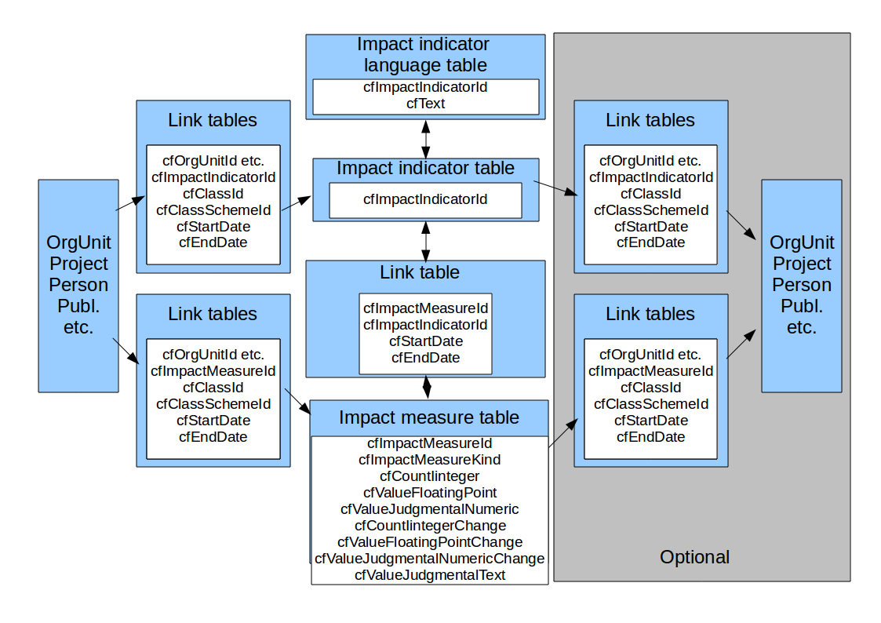
Measuring Impact in CERIF (MICE)
www.eurocris.org
www.eurocris.org
MICE, a JISC-funded Project coordinated by Richard Gartner, Kings College, London, UK

Slide 22
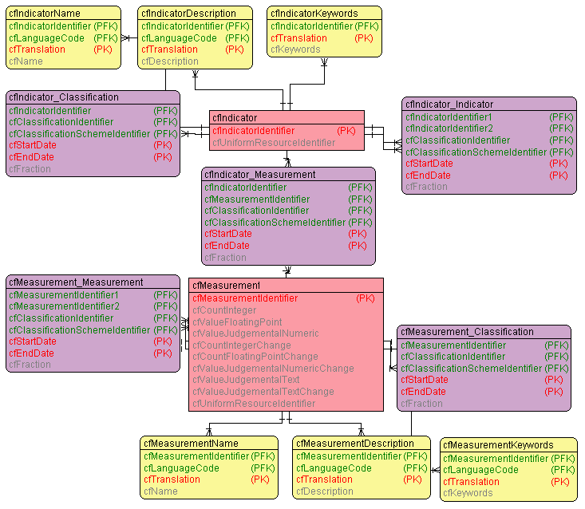
CERIF Measurement & Indicator
www.eurocris.org
www.eurocris.org
Is an Aggregation Entity
cfMeasureIdentifier
cfCountInteger
cfCountIntegerChange
cfValueFloatingPoint
cfCountFloatingPointChange
cfValueJudgementalNumeric
cfValueJudgementalNumericChange
cfValueJudgementalText
cfValueJudgementalTextChange
cfURI

Slide 23
Measurement & Indicator (some examples)
www.eurocris.org
  economic and commercial
    economic
      impact on business
        improving performance of existing businesses
          increased turnover by 1.2M€ in 2012
          time savings of 14.56%
          reduced costs by 42%
        new products/processes
          creating numbers of new products/services
          commercialising / other success measures
Indicator
Measurement
Extract from the MICE List of Indicators

Slide 24
CERIF 1.5
www.eurocris.org
cfFederated Identifier
cfFunding
cfEquipment
cfExpertise
AndSkills
cfFacility
cfResult
Publication
cfService
cfQualification
cfPrize
cfResultPatent
cfResultProduct
cfElectronicAddress
cfProject
cfPostalAddress
cfCurriculum
Vitae
cfPerson
cfOrganisation
Unit
cfGeographic
BoundingBox
cfCitation
cfIndicator
cfMeasurement
cfEvent
cfCountry
cfLanguage
cfCurrency

Slide 25
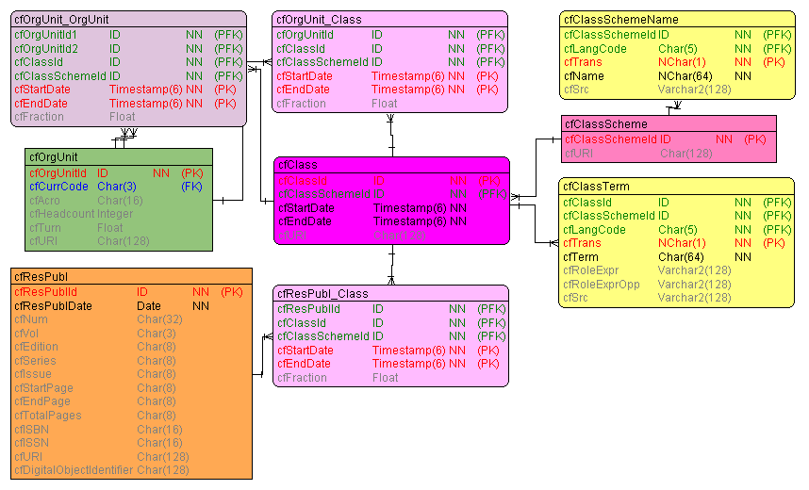
CERIF – Generic Entity Structure
www.eurocris.org
www.eurocris.org
Generic
Identifier
URI
Attributes
Multilingual Entities
Relationships (Links)

Slide 26
Some CERIF Link Entities
www.eurocris.org
www.eurocris.org
ExpertiseAndSkills
Funding
Equipment
Facility
Qualification
Service
Prize
ElectronicAddresse
CV
PostalAddress
Citation
Metrics
Indicator
Measurement
Geographic
Bounding Box
Event
Language
Currency
Country

Slide 27
Some CERIF Link Entities
www.eurocris.org
www.eurocris.org
ExpertiseAndSkills
Funding
Equipment
Facility
Qualification
Service
Prize
ElectronicAddresse
CV
PostalAddress
Citation
Metrics
Indicator
Measurement
Geographic
Bounding Box
Event
Language
Currency
Country
role=author‘s affiliation
role=author
role=deliverable
role=research assistant
role=coordinator
role=principal investigator

Slide 28
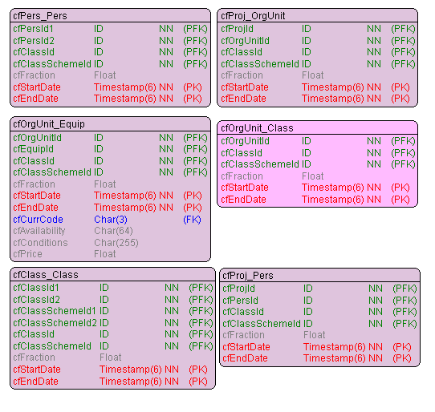
Some CERIF Link Entities
www.eurocris.org
www.eurocris.org

Slide 29
Result_Publication Instance Diagram
(slide by Keith Jeffery)
www.eurocris.org
www.eurocris.org
OrgUnit M
Part of
member
Person A
OrgUnit O
employee
member
OrgUnit N
Project leader
Part of
Project P
author
owns IPR
Publication X

Slide 30
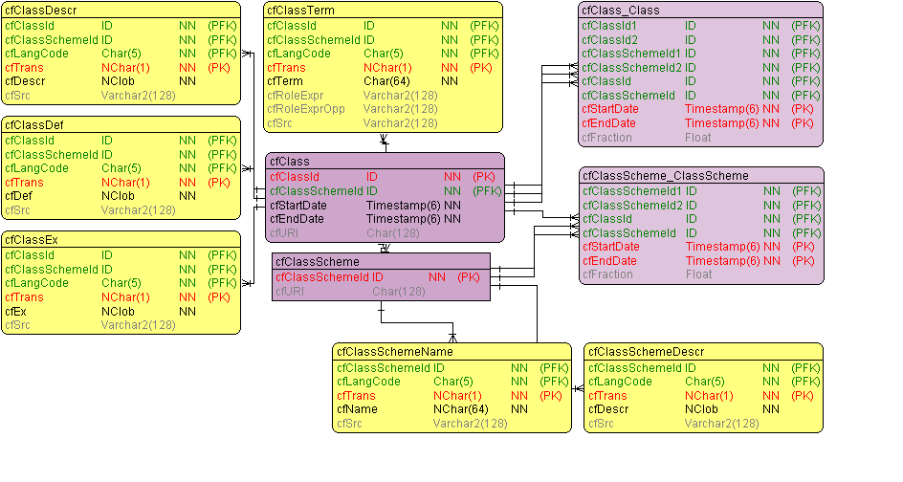
CERIF Semantic Layer
www.eurocris.org
www.eurocris.org
Allows to capture any Schema or Structure
Flat Lists
Thesauri
Classification Systems (e.g. SKOS, ...)
Taxonomies
Ontologies
Open / Extensible in all directions
New Schemas
New Concepts / Terms
New Relationships
Enables to manage
Roles / Types Semantics
Subject Headings
Archiving (Time component)
Allows for simple Mappings between Schemes

Slide 31
CERIF Semantic Layer (Declared Semantics)
www.eurocris.org
www.eurocris.org
Recursion
is-a
maps-to
is-part-of
Is-broader-term
Scheme-Assignment
Time-based

Slide 32
CERIF 1.5
www.eurocris.org
cfFederated Identifier
cfFunding
cfEquipment
cfExpertise
AndSkills
cfFacility
cfResult
Publication
cfService
cfQualification
cfPrize
cfResultPatent
cfResultProduct
cfElectronicAddress
cfProject
cfPostalAddress
cfCurriculum
Vitae
cfPerson
cfOrganisation
Unit
cfGeographic
BoundingBox
cfCitation
cfIndicator
cfMeasurement
cfEvent
cfCountry
cfLanguage
cfCurrency

Slide 33
CERIF Federated Identifiers
www.eurocris.org
ResultPublication
  DOI
  WoS Accession Number
Person
  Social Security Number
  Staff Id in HR system
  Author identifier
    ORCID
    ScopusID
Project/Grant
  Funder’s reference number
Organisation
  VAT Identification Number
  Internal Code
  FundId
Classification
  External Code

Slide 34
CERIF Federated Identifiers
www.eurocris.org
Records the “tag” by which an object is known elsewhere
For any Base, Result, Infrastructure, or 2nd Level entity
Connected to a Service representing the context:
  The issuer of the identifier
    Usually an information system

Slide 35
CERIF XML 1.5 Interchange Format
www.eurocris.org
www.eurocris.org
  For point-to-point interchange
  XML namespace
  XML Schema
    Based on the ER model
cfFunding
cfFederated Identifier
cfEquipment
cfExpertise
AndSkills
cfFacility
cfQualification
cfResult
Publication
cfService
cfPrize
cfResultPatent
cfResultProduct
cfElectronicAddress
cfProject
cfPostalAddress
cfCurriculum
Vitae
cfPerson
cfOrganisation
Unit
cfGeographic
BoundingBox
cfCitation
cfIndicator
cfMeasurement
cfEvent
cfCountry
cfLanguage
cfCurrency

Slide 36
CERIF 1.5 XML Interchange Format
www.eurocris.org
www.eurocris.org
<CERIF xmlns=“urn:xmlns:org:eurocris:cerif-1.5-1”>
<cfProj>
<cfProjId>internal-project-identifier</cfProjId>
<cfAcro>ACRO</cfAcro>
<cfURI>http://www.project-url.ac.uk/acro.html</cfURI>
<cfTitle cfLangCode="en" cfTrans="o">The title of the project</cfTitle>
<cfAbstr cfLangCode=”en" cfTrans="o">The goals of the project</cfAbstr>
<cfProj_Class>
<cfClassId>infrastructure-project-uuid</cfClassId>
<cfClassSchemeId>-project-types-scheme-uuid</cfClassSchemeId>
</cfProj_Class>
<cfProj_OrgUnit>
<cfOrgUnitId>orgunit-1-identifier</cfOrgUnitId>
<cfClassId>coordinator-uuid</cfClassId>
<cfClassSchemeId>orgunit-project-roles-scheme-uuid</cfClassSchemeId>
<cfStartDate>from-datetime</cfStartDate>
<cfEndDate>to-datetime</cfEndDate>
</cfProj_OrgUnit>
</cfProj>
</CERIF>

Slide 37
CERIF 1.5 Release
www.eurocris.org
www.eurocris.org
  CERIF Model Introduction and Specification coming
  CERIF XML Data Exchange Format Specification ✓
  CERIF Formal Semantics (Vocabulary) ✓
  CERIF SQL Scripts ✓(euroCRIS members only)
  CERIF XML Schemas ✓
  CERIF XML Examples ✓
  CERIF Semantics (Excel) ✓

Slide 38
Ongoing Activities: CERIF 1.6
www.eurocris.org
www.eurocris.org
Model Cleaning
Research Data
Cross-TG Activities
  Linked Open Data TG
  Institutional Repositories TG
  Architectures TG
  Indicators TG
  Best Practice TG
Cooperation with
  CASRAI
  VIVO
  RDA
  ORCID
cfFunding
cfEquipment
cfFederated Identifier
cfExpertise
AndSkills
cfFacility
cfQualification
cfResult
Publication
cfService
cfPrize
cfResultPatent
cfResultProduct
cfElectronicAddress
cfProject
cfPostalAddress
cfCurriculum
Vitae
cfPerson
cfOrganisation
Unit
cfIndicator
cfMeasurement
cfGeographic
BoundingBox
cfCitation
cfEvent
cfLanguage
cfCurrency
cfCountry

Slide 39
What makes CERIF shine
www.eurocris.org
Right level of abstraction
Normalized model
  Record data only once
  Reference rather than copy
Versatile Semantic Layer
Time-based relationships
Clean design, regular structure

Slide 40
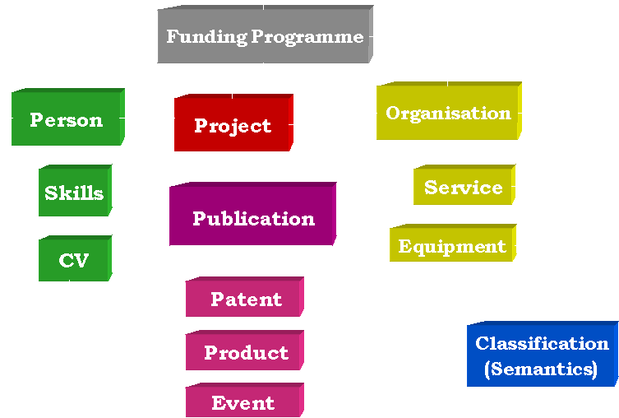
What is a CRIS?
www.eurocris.org
www.eurocris.org
Current
Research Information
System
= CRIS
… that means
of current interest
not necessarily ongoing
… information about
Researchers
Organisations (Research-performing, Funding)
Funding Programmes, Calls
Projects
…
… driven by
Concepts
Model
Implementation (Information System)
CERIF
an integrated approach towards managing research information

Slide 41
CRIS and Repositories at an institution
(slide by Keith Jeffery)
www.eurocris.org
www.eurocris.org
End-User
CERIF
CRIS
Research Context
[projects, persons, organisational units
funding, products, patents, publications
facilities, equipment, events]
CERIF
Various
protocols
OAI-PMH
OA Repository
(hypermedia) Documents
e-Research repository
Datasets and Software

Slide 42








www.eurocris.org
International Council for Science;
Commission on Data Access
European Association of Research
Managers and Administrators
www.eurocris.org
All European Academies

